Slide 1

Kenn Apel, Josh and Megan Hanselman, Kate Lansing, Mary Lou Morris

Slide 2
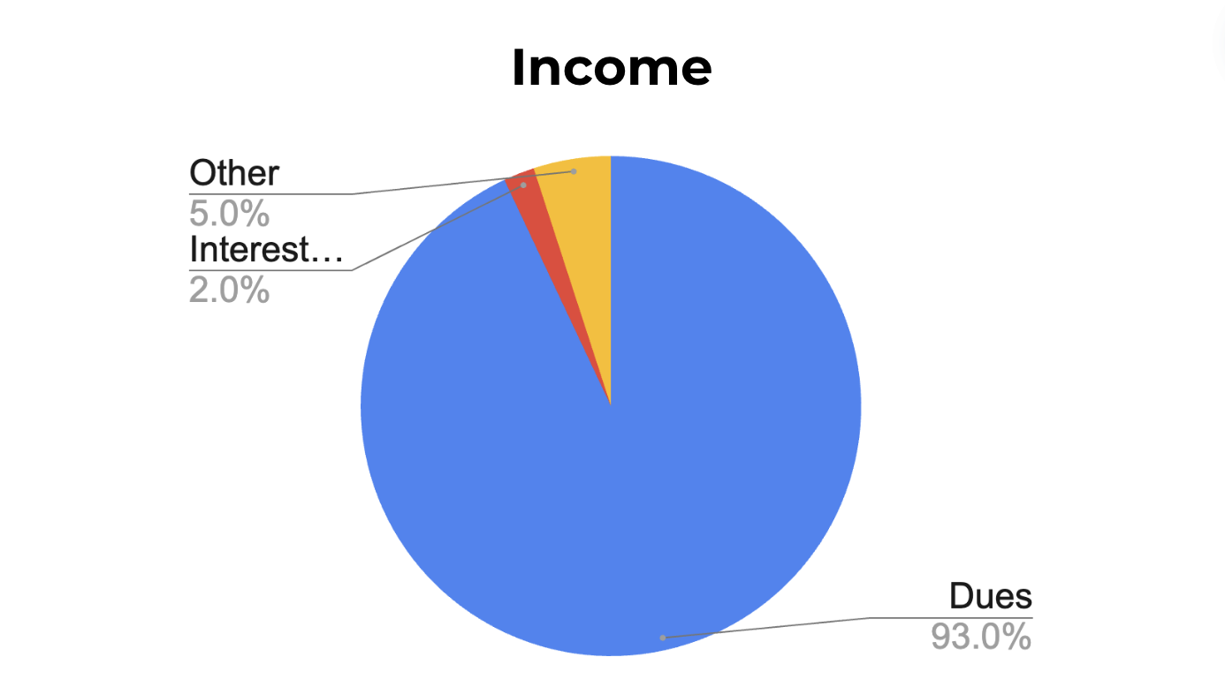
Total = $294K; Does not include the $85K from reserves for this year
Interest and late fees
Other: diaper sales, pool fees, transfer fees…
Notes:
Other =

Slide 3
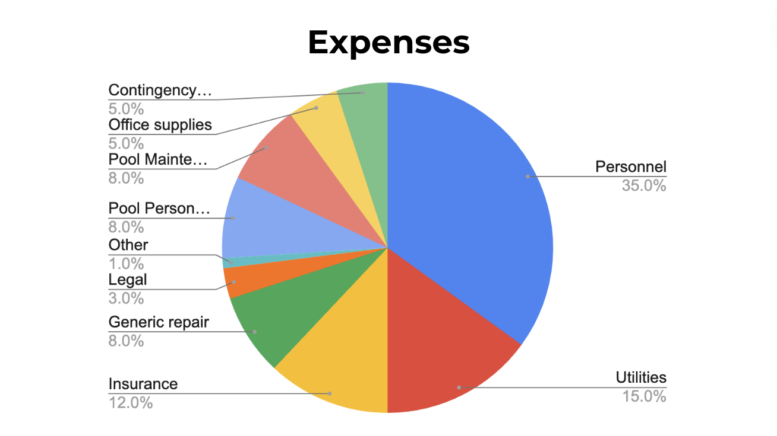
Basic Operating Budget - $294K (does not include the $85K from reserves for this year)
Contingency
Pool Maintenance
Pool Personnel
Other: committee expenses, doggie stations, etc.

Slide 4
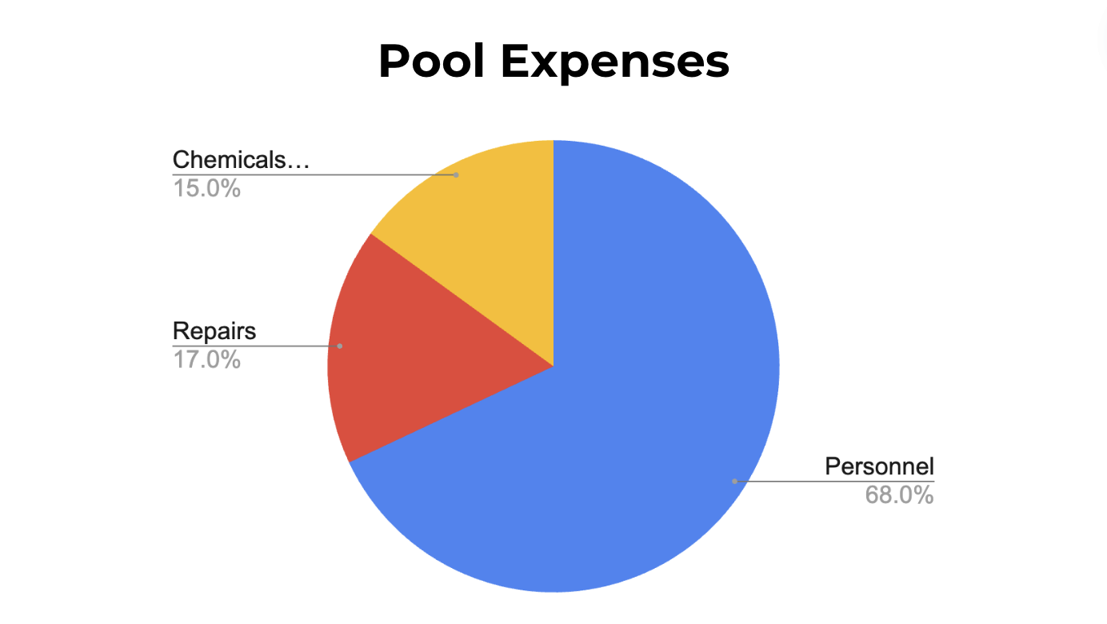
*
Chemicals and Supplies
* Total of $34K

Slide 5
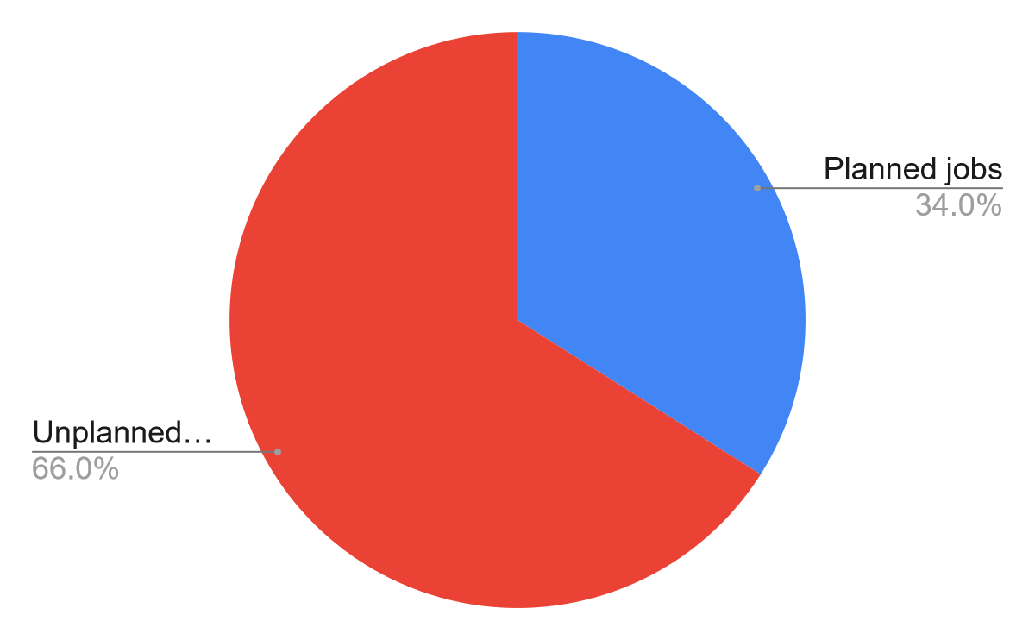
Current Planned and Unplanned Maintenance in 2024 ($119K est.*)
West-side siding & windows
Accessible door
Tennis court resurfacing
Pool leak
Repair of pool divot
Pool refill
*Board approved using $85K from reserves to meet planned maintenance

Slide 6
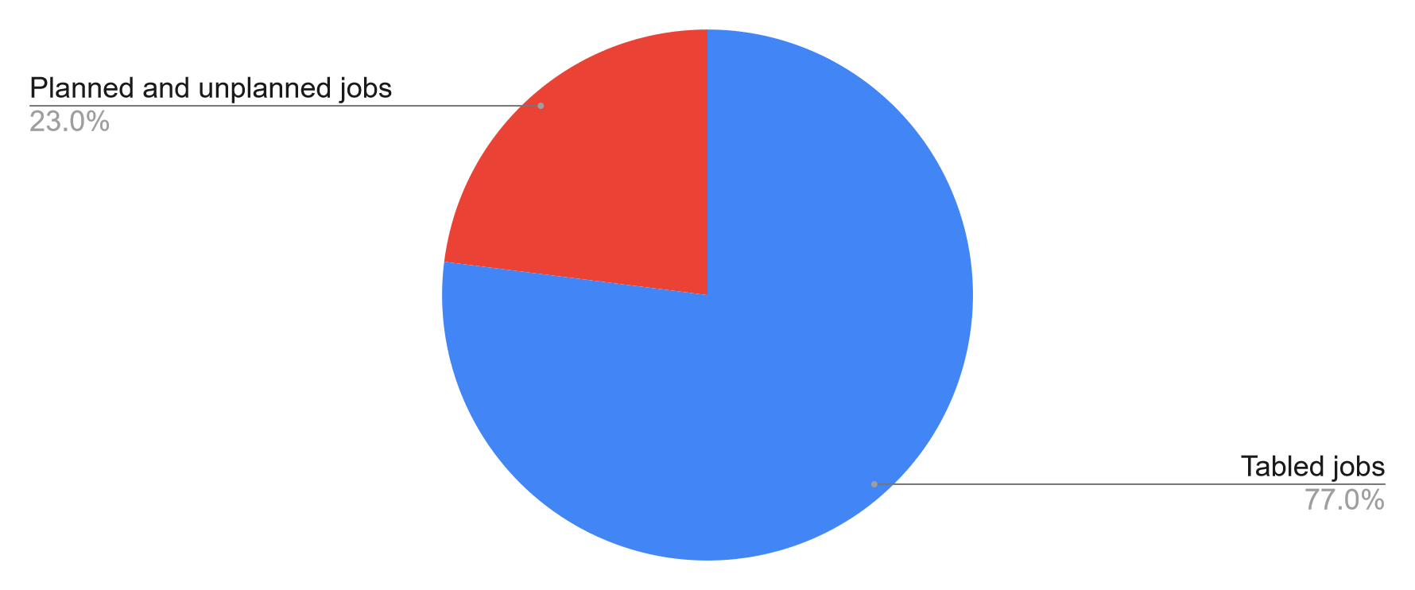
Current Planned and Unplanned Maintenance and Tabled Items in 2024 ($510K est.)
Overdue, planned, and unplanned jobs
Pool repairs
West side of clubhouse
Court resurfacing
Clubhouse renovation
Tennis court fence replacement
Propane tank

Slide 7
Bayshore’s Reserves (Savings)
$426K*
*After planned $85K taken for this year’s budget

Slide 8
Bayshore’s Future Financial Status
Based on projections (0-7%) of current budget, Bayshore may have an average of $2,537 in discretionary funds for each of the next fiscal eight years (approx. $20K across eight years)
Along with our current reserves, this estimate does not meet the required funds needed for planned maintenance jobs (much less unplanned jobs and tabled items)
Reminder: this year, unplanned costs are estimated to be $78K
Bayshore’s 30-year maintenance plan for property, facilities, and equipment for the next eight years combined is estimated at $500,000

Slide 9
Where Does Bayshore Get The Needed Funds For The Next 8 Years?
3 Hypothetical Options

Slide 10
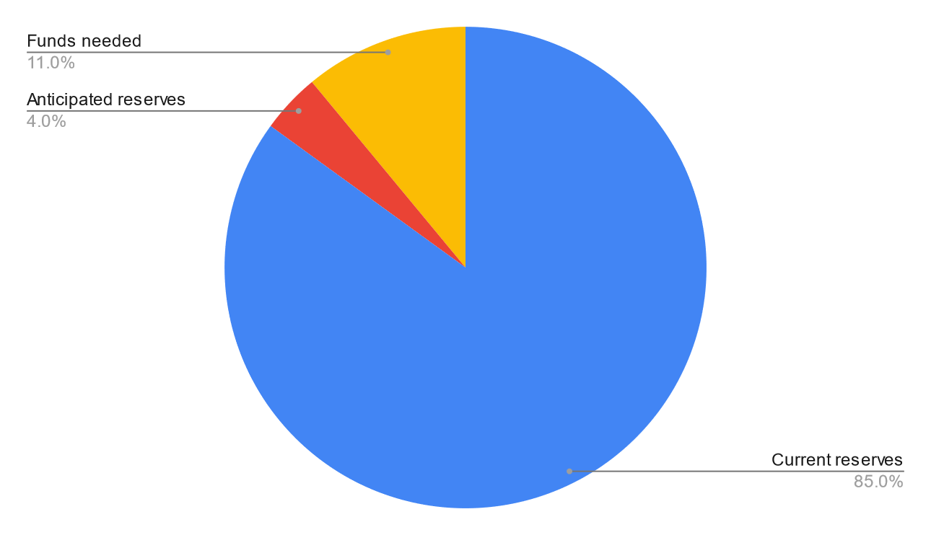
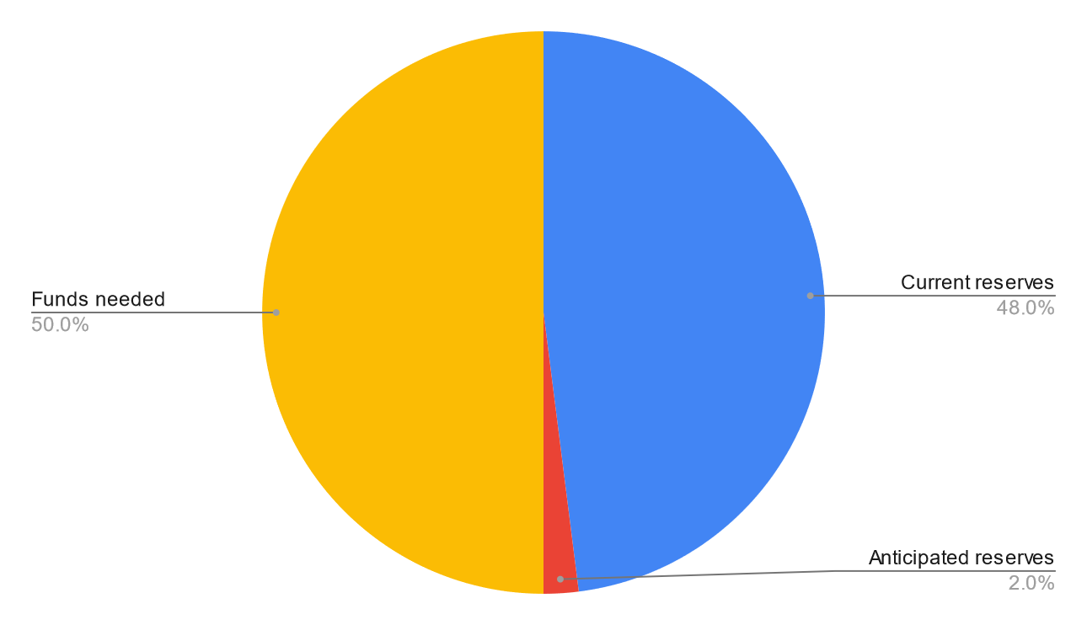
Where Does Bayshore Get The Needed Funds For The Next 8 Years?
Option #1: Use ALL our current reserves (savings)
$53,707
$462,643
30-year plan only: $500K est.
Including tabled items: $891K est.

Slide 11
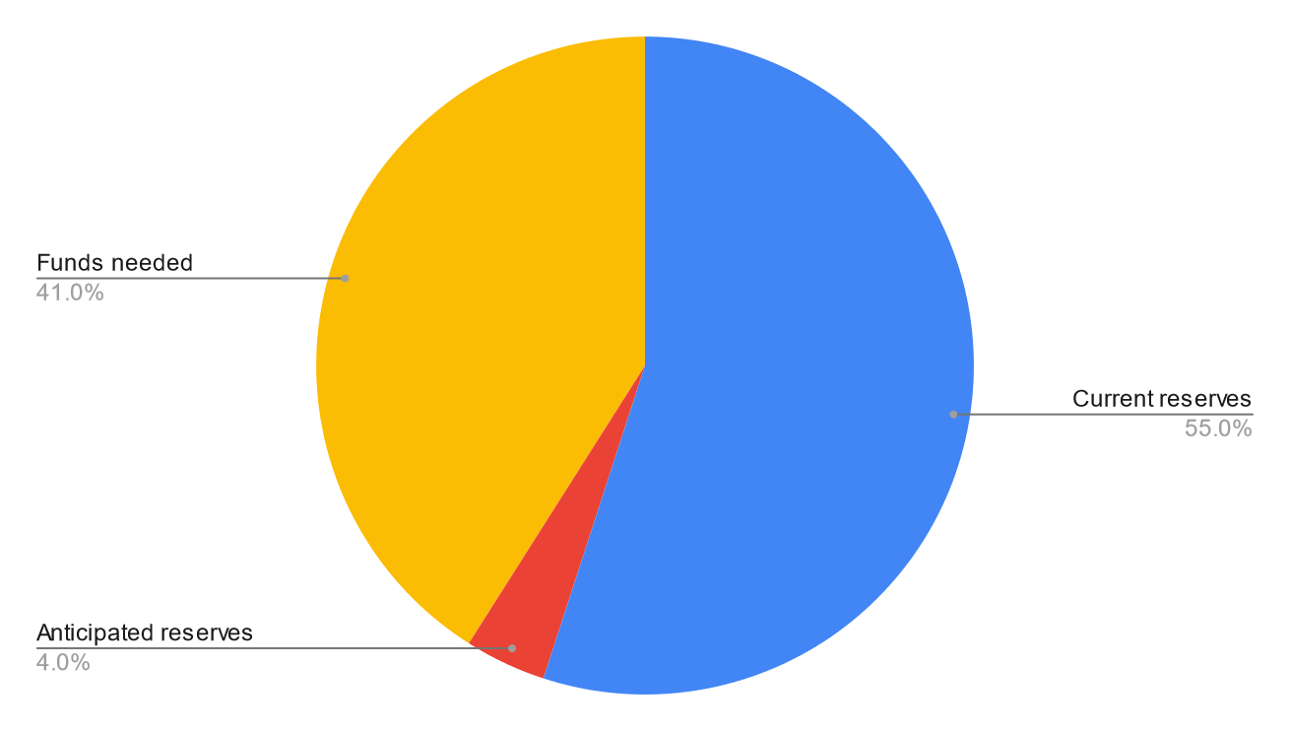
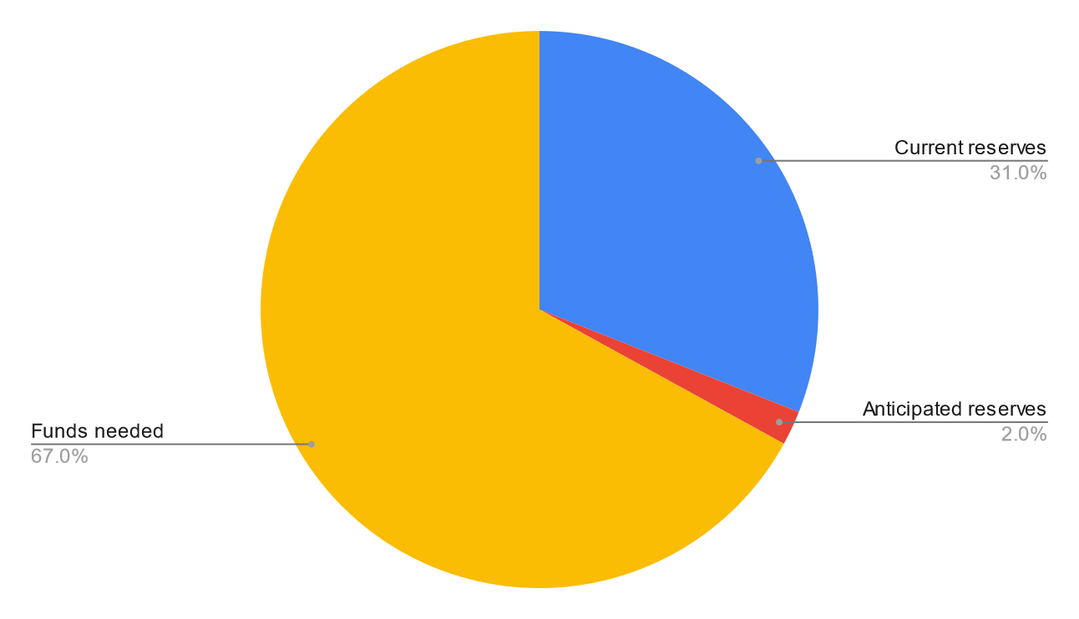
Where Does Bayshore Get The Needed Funds For The Next 8 Years?
Option 2: Use all but $150K our current reserves
$203,707
$594,7070
30-year plan only: $500K est.
Including tabled items: $891K est.

Slide 12
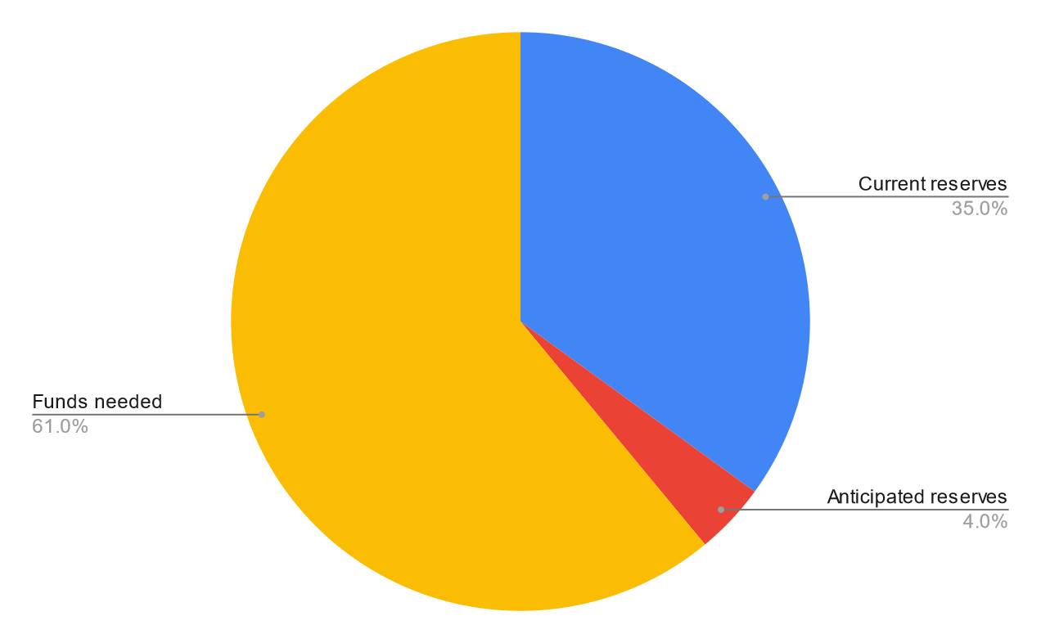
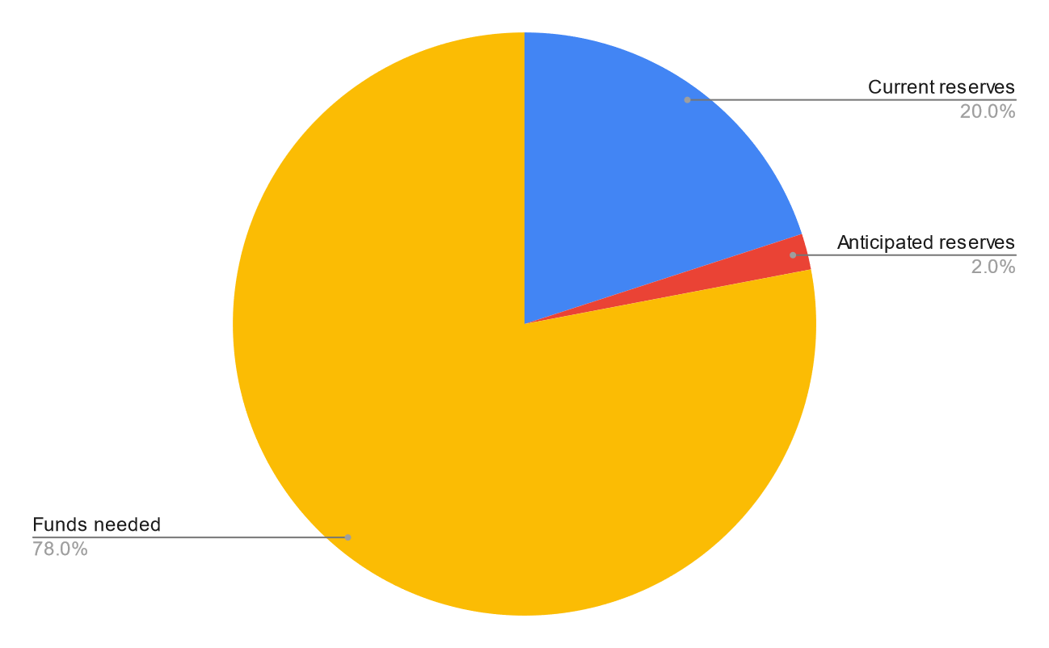
Where Does Bayshore Get The Needed Funds For The Next 8 Years?
Option 3: Use all but $250K of our current reserves
$303,707
$694,707
30-year plan only: $500K est.
Including tabled items: $891K est.

Slide 13
The Three Options Do Not Account for Unplanned Expenses
With any of those three options, additional funds are needed to maintain Bayshore’s amenities across the next 8 years, anywhere from $54K to $700K
Living in an HOA has many positive aspects

Slide 14
Positive Aspects of Bayshore (an HOA)
Members have access to:
Pool
Rec room
Clubhouse facilities, including free classes and use for members’ events
Social events
Tennis court
Playground
Two other “natural” parks
Backyard patio
Many beach accesses
Planning committee to monitor C&R rules (house conformity, trees, etc.)
Members benefit from the many volunteers who help maintain and improve Bayshore’s amenities and facilities
Members also benefit financially from living in an HOA

Slide 15
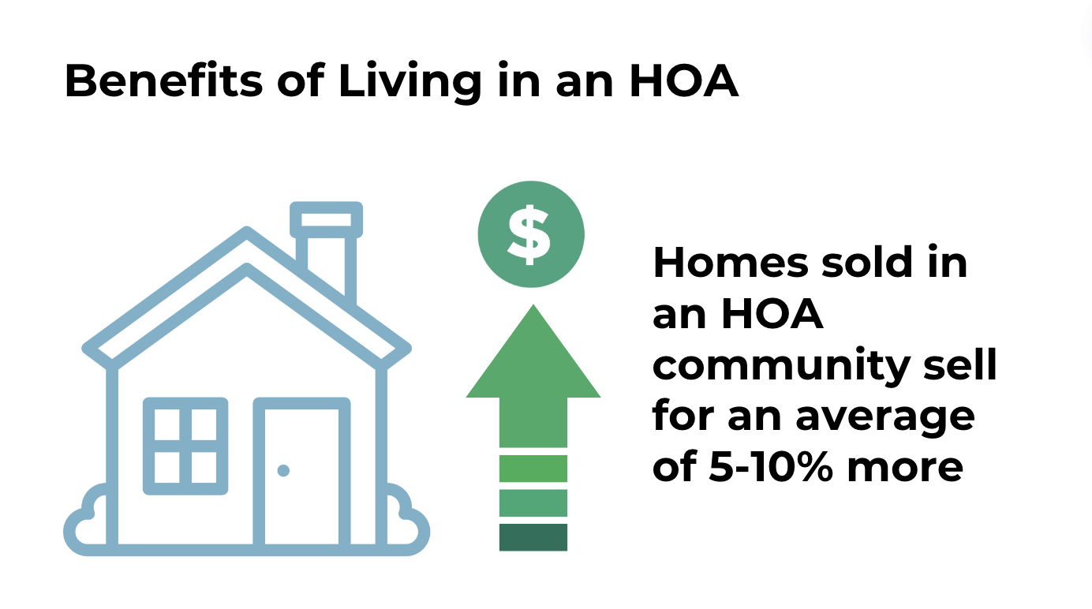

Slide 16
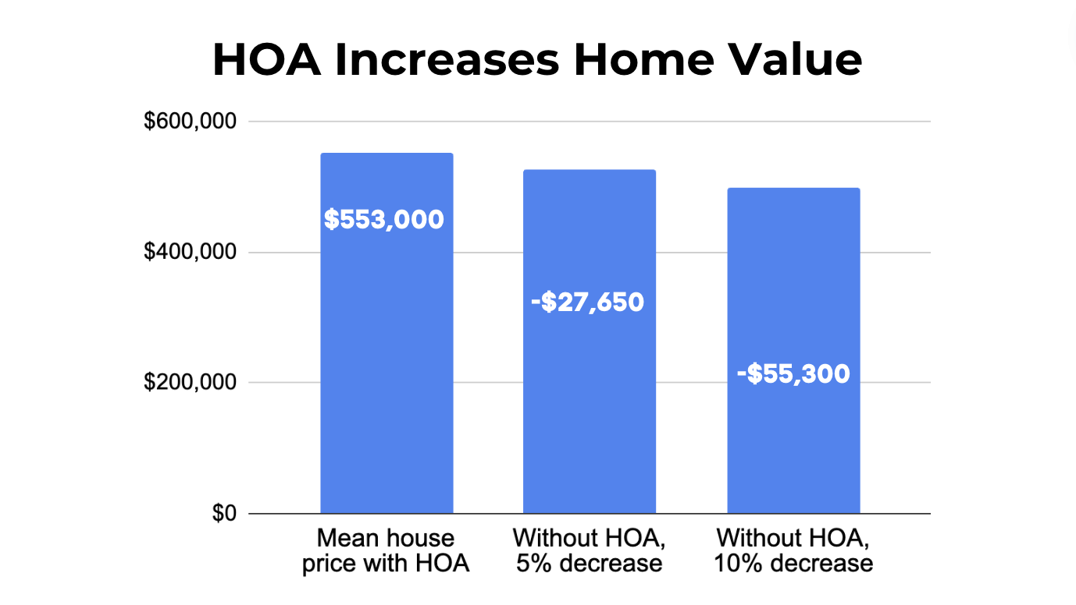

Slide 17
Future of Bayshore
To maintain Bayshore as a viable HOA, some additional financial resources are required

Slide 18
Questions?

