Slide 1
Results of Dues Task Force Survey
Members: Kenn Apel, Josh Hanselman, Megan Hanselman, Kate Lansing

Slide 2
Format for Presentation
Present summary of main points on survey
Note: There were 287 responses. Of those, 15 had the same member number and 31 did not know their member number.
Discuss themes from members’ comments on survey
Present comments that appear based in misinformation, misconceptions, and miscommunications
Provide the Task Force’s recommendations to the Board
Open the floor for comments and questions

Slide 3
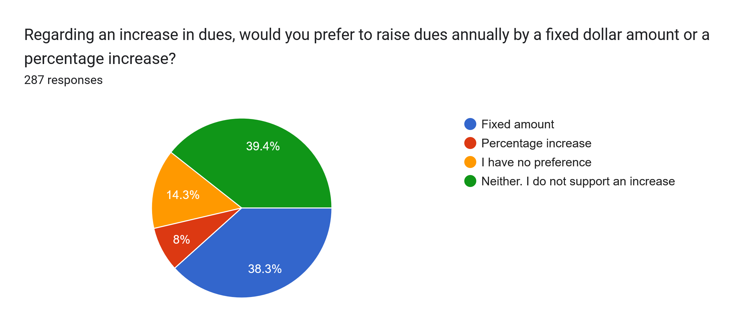
60.6% chose some type of increase

Slide 4
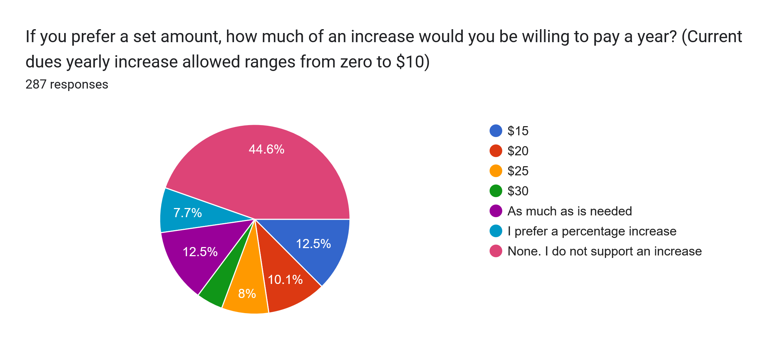
55.4% chose some type of increase

Slide 5
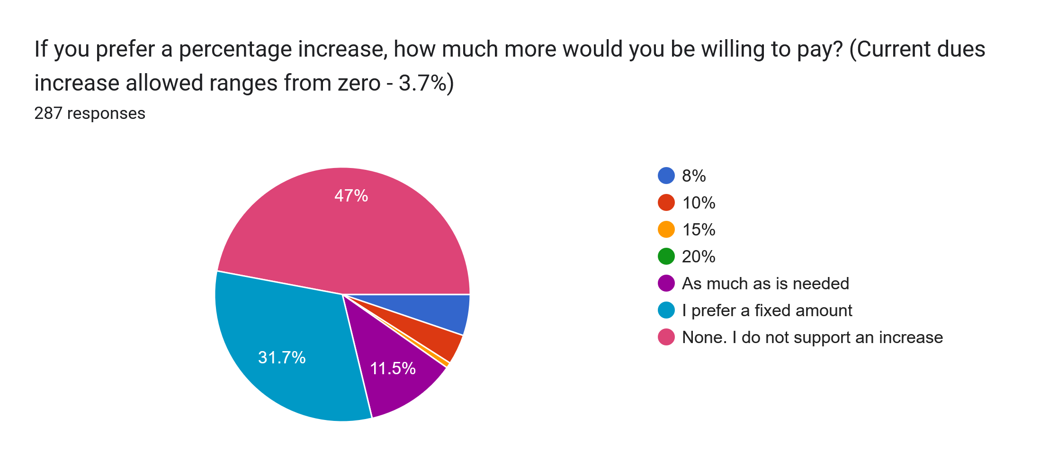
53% chose some type of increase

Slide 6
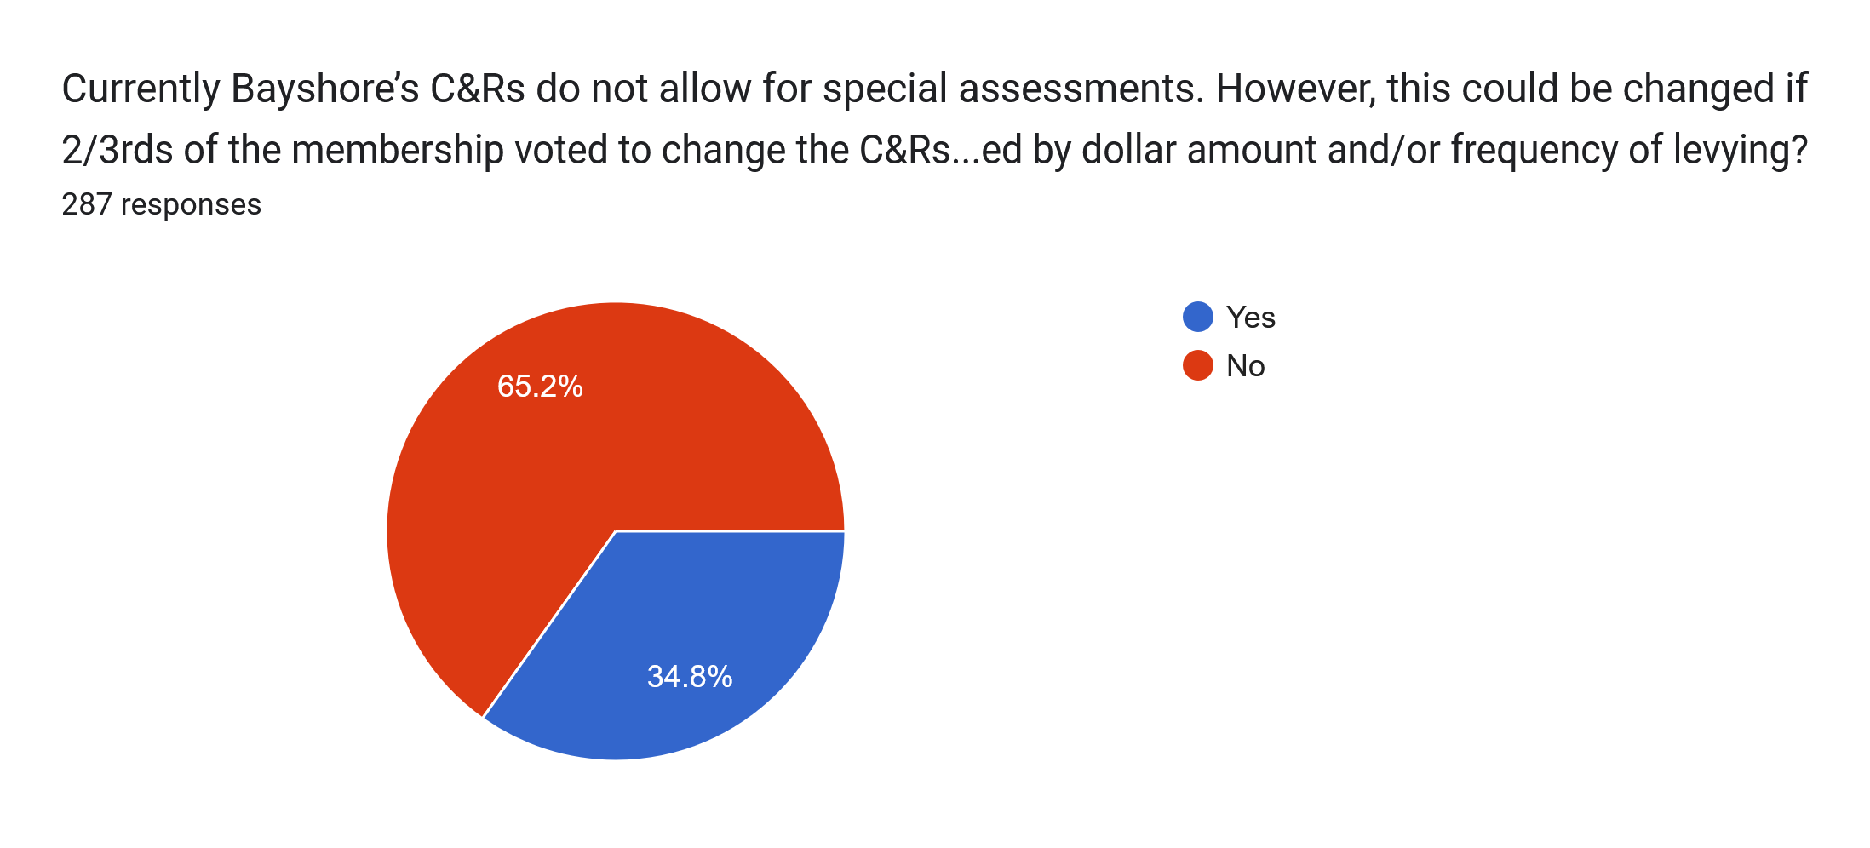
Currently Bayshore’s C&Rs do not allow for special assessments. However, this could be changed if 2/3rds of the membership voted to change the C&Rs. Would you support a change to the C&Rs to allow for special assessments, if the assessments were limited by dollar amount and/or frequency of levying?

Slide 7
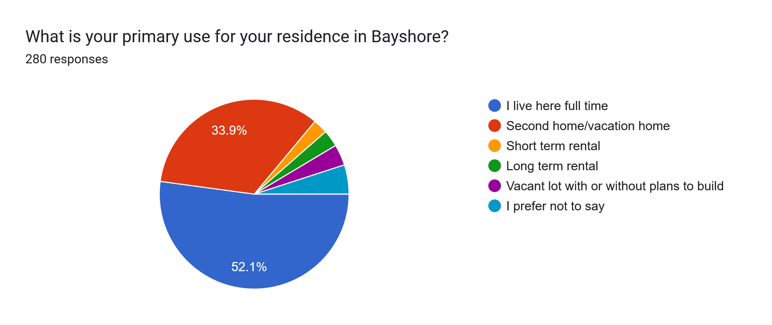

Slide 8
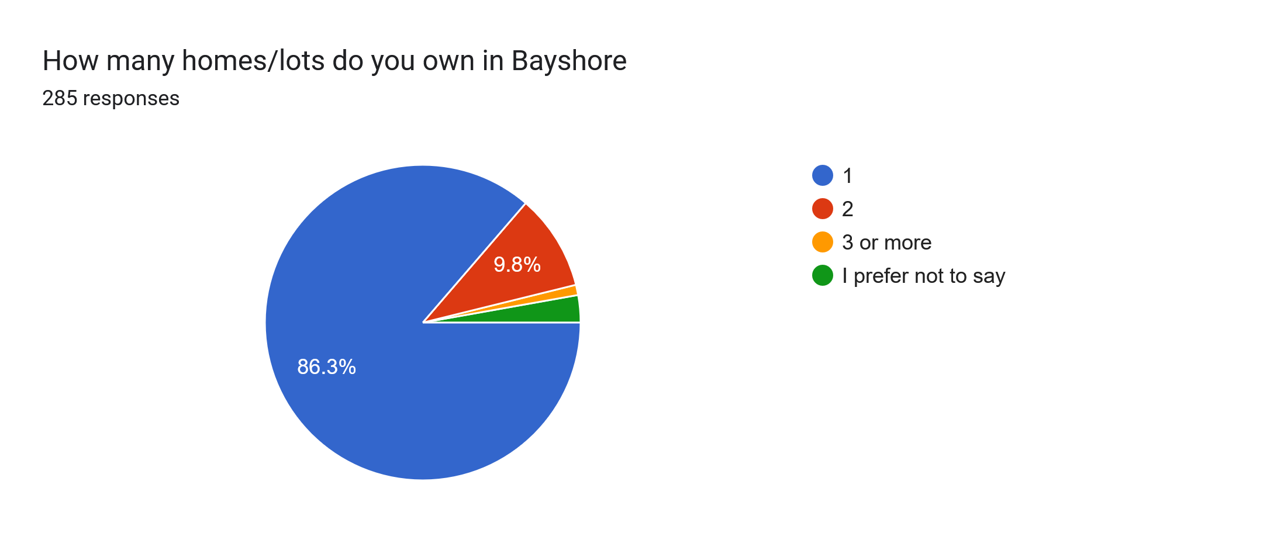

Slide 9
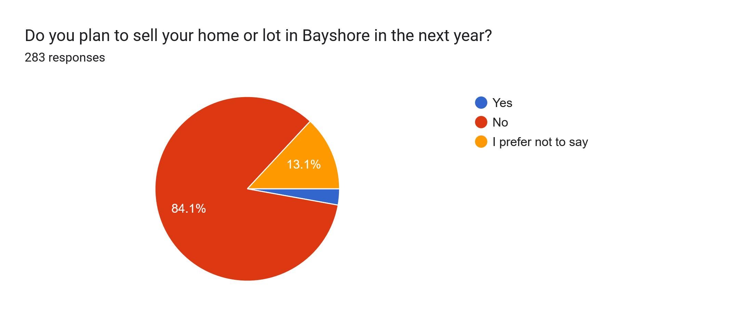

Slide 10
Themes from Member Comments

Slide 11
Comments on the Amenities Themselves
Following points are direct member comments;
“Quick Comments” are from the Task Force

Slide 12
Clubhouse/Pool are Rarely Used
Feel the amenities are not used by the majority.
I believe it (pool) is used mostly on the weekend renters and property owners are paying for it.
Why not get rid of the pool, especially if it is not used except by a very small percentage of members?
Not all of us use the amenities.
We purchased a home to live in, not amenities we will never use.
I would wager that most months would show blank dates (in clubhouse), or, at best, a very low percentage of usage by full-time residents, such as myself.

Slide 13
Amenities Cost So Charge (Members)For Them
People who use Bayshore’s facilities should pay.
Charge everyone to use the pool, not just guests. Members can pay $1-2 every time they use the pool.
On a charge as you use basis.
Let those who use it pay for it.
Rather than allocating money from the dues for social events, perhaps you could charge a fee to those that want to attend them.

Slide 14
Get Rid of the Amenities
Sell the damn property!
Did not buy here for the amenities.
Close the clubhouse… problem solved.
Sandpiper and Ocean Hills both have HOAs, yet neither have a "central facility" (clubhouse) or a pool.
The clubhouse requires ongoing staffing as well as without generating much rent income. Not sure the pool could break even on its own with a simple outbuilding dressing room without the drag of the underused clubhouse.

Slide 15
Quick Comments
Pool Use: For an average summer week (2024), there were 686 visits/uses (93% were members and their families; 7% were renters of Bayshore homes)
Clubhouse Use: Across an average week, the clubhouse is used for scheduled meetings/activities approximately 4 hours/day. These numbers don’t include use of the rec room or special Bayshore events (e.g., holiday party, holiday bazaar, pancake breakfast, meet-n-greet) and other private events (e.g., birthdays, prom, weddings). Last year, the clubhouse was rented 9 times; this year it scheduled to be used 12.
Committee expenses are about 1% of the annual operating budget.

Slide 16
Shift Maintenance Costs Away From (Some) Members
Following points are direct member comments
“Quick Comments” are from the Task Force

Slide 17
STRs Should Pay More Dues
I believe you should charge STR companies MORE than permanent residents.
Tax vacation rentals they make a fortune.
Owners of *businesses* (STRs) in our *residential* neighborhood should be expected to pay much more than those of us who actually live here full-time. Raise dues on commercial dwellings.
Many people have strained budgets now with inflation, price of eggs / groceries, raises in utilities, taxes, etc. Homeowners can not continue to be the ones who shoulder all the costs.

Slide 18
Raise Funds Without Increasing Dues
Ask for donations.
Sell concessions at the pool.
Get volunteers for repairs.
Bake sale.
Have work parties.
Sell bricks for various levels of support.
Rent out the clubhouse for weddings, events to surrounding communities.

Slide 19
Focus on the Board and Its Performance
Following points are direct member comments
“Quick Comments” are from the Task Force

Slide 20
Questioning the Current/Past Boards’ Work
YOU WASTE MONEY!
You are terrible with money and decision-making in general.
We don’t trust you to make decisions about our long-term assets.
You wasted too much money in the past time to STOP.
Why wasn’t the clubhouse siding properly maintained?
The members of the past board of directors were responsible for this situation, let them alone pay to fix the financial problems.

Slide 21
Current Budget/Reserves Should Pay for Maintenance Costs
Readjust budget.
Suggest a reduction in expenses rather than an increase in dues.
The Board needs to priorities the projects and operate within the budget they have allocated to them by the members.
Save money. There are many things we can cut out of our frivolous spending.

Slide 22
Quick Comment
With a 10% budget cut ($29,405) to the current operating budget, dues would need to go up 4% each year for the next 8 years to ensure all scheduled maintenance work could be done.

Slide 23
Reasons for Not Supporting Dues Increase/Special Assessment
Following points are direct member comments
“Quick Comments” are from the Task Force

Slide 24
Quality of Life/Inflation
Many of us moved here to retire and relax not to have our HOA raised very year.
Many of us did not retire from California and have much lower incomes and would like to maintain our lifestyle here.
Some of our full-time residents have low, fixed incomes.
On fixed income. Already struggling to keep up.
Wanna go to dinner.

Slide 25
Solutions for Dealing with Maintenance Costs
Following points are direct member comments
“Quick Comments” are from the Task Force

Slide 26
Develop a Special Assessment
Issue a special levy over 5-10 years and have members vote on that.
I think the special assessment option merits further investigation. Its use would have to be carefully limited to avoid abuse, but precisely crafted language which defines circumstances for its use might pass muster with the membership.
I prefer an “assessment” be levied over two or three years and leave the HOA guidelines as they are.
We would be open to a one time levy up to $100 at this time.
Why not go for an assessment, get the money do the repairs in a timely manner and be done with it?
Why not consider an initial "catch-up" dues increase of $50 per year ($4 per month) with the stipulation that that money must be set aside and used only for capital projects?

Slide 27
Stagger Projects
Do projects incrementally.
Everything does not need to be done at once.
Keep the $10 limit. Use the reserves to do 1-3 projects a year. What is within budget. Like we homeowners do.

Slide 28
Grants
Apply for grants
Is there any grant we could apply for since clubhouse is used for some community activities, and may serve as emergency shelter?
As I am assuming (the clubhouse) is approaching 50 years of age and may actually be able to receive grants and support from the Oregon State Historic Preservation Office to help maintain it — although this comes with considerations - such as does the building still retain its original character etc.

Slide 29
Dissolve Bayshore
Dissolve the HOA and liquidate its assets.
Is displacing the “HOA” an option?
Not sure if the HOA can be abolished with a majority vote.

Slide 30
Use Differential Dues Structure
Since Short Term Rental properties are businesses that are income generating and are different from owner occupied homes, they should pay an additional (Business) Association fee. It would be the cost of doing business here. I recommend a 50% increase for all STRs.
Most residences in Division 1 by the motel are not as expensive as the newer residences currently being built. It’s not equitable to raise their dues.
Request or require money from individuals based on their income value and/or household income.
Our community is roughly divided into three different groups: full time residents, second-homers, and commercial operations. Perhaps we should consider three different membership rates, based on these categories.
What if a discount were given to full time residents? And a higher rate assigned properties occupied part time or used as rental property or Airbnb?

Slide 31
Quick Comments
A special assessment strategy will require 2/3rds of members’ votes.
Bayshore’s 30-year maintenance plan includes staggering projects.
With no HOA, neighbors can:
Grow their trees, and build fences, as high as they wish,
Use burn barrels in their yards,
Have noxious plants in their yards,
Let their pets roam neighborhoods,
Park boats of any size and/or RVs in their yards, and
Build houses/second stories to any height they wish.
With no HOA, beach accesses will not be maintained.

Slide 32
ADA Concerns
Comments on ADA/Accessibility
Following points are direct member comments
“Quick Comments” are from the Task Force

Slide 33
ADA Concerns/Comments on Accessibility
We do not need a complete change to the lady's bathroom since a handicap portable can be placed in the pool area.
No need to waste thousands on a full plan for the clubhouse to make it ADA compliant that will be outdated in two years.
I believe the repairs are being inflated and bring the bathrooms up to ADA compliance is something we should not do.
Stop representing that you must make FHA improvements as a mandate. This is only true if you are opening facility to people other than members and this practice can be stopped.
We are not subject to ADA rules, so quit trying to spend obscene amounts of money on it.
I believe the repairs are being inflated and bring the bathrooms up to ADA compliance is something we should not do

Slide 34
Quick Comments: Crucial ADA points
ADA was developed in 1990 (President George H.W. Bush) and was last updated 11 years ago.
The Clubhouse is open to members and non-members, which means Bayshore needs to think about ADA and Fair Housing (FHA) issues.
Bayshore falls under ADA guidelines (Sec. 12181) because it is open to the public (more on being open to the public later).
Bayshore must ensure all individuals have full and equal access to its facilities (Sec. 12182).
Could Bayshore be sued for non-ADA compliance? Yes.
Costs associated with a lawsuit:
Potential compensatory damages: $50-$300K
Potential first violation penalty: $75K
Potential cost of legal fees for defense in court: $15-25K

Slide 35
Support for Changes to the C&Rs
In order to maintain the club house these repairs are a must to protect our investments.
In your report, you mention 61 "missed opportunities" that would have allowed the dues to be $620 or so today. That is a realistic number given comparable HOA fees and the rapid increases in inflation.
I am highly supportive of a dues increase to maintain the quality of the community.
I think it’s reasonable to raise the dues. It’s very inexpensive currently.
I suggest a short-term higher rate to help cover the cost needed and a $20 a year increase as deemed necessary over the long term. I do think an increase is justified.
Dues much too low considering the number of property owners and the amenities, care, maintenance, etc. in a marine environment in a tsunami zone.
We need to pay for the kinds of amenities that led us to buy in Bayshore.
We have an exceptional club. Let’s keep it that way.

Slide 36
Misconceptions Miscommunications Misinformation
Points are direct member comments; information in red are facts provided by the Dues Task Force

Slide 37
Mobi-Mat Project and Clubhouse Elevator
We do not need special services for wheelchairs as they have those already near by.
Stop spending the money on the mobile mat projects.
Replace the roof rather than installing handicap paths to the beach.
Bayshore will be putting in an elevator.
We do not need an elevator since we have a ramp for entry to the upper level.
Facts: Bayshore is not paying for Mobi-Mat project. All funds are from grants and donations. There is no plan to install a clubhouse elevator.

Slide 38
Comments Pertinent to the Special Road District
Do not need a person to mow strip periodically in front of our house.
Did not need flashing stop sign.
Did not need giant humps.
Stop spending money on stupid things…like the ridiculously high speed bumps (twice), the corner crap at Bayshore and Westward….
I have to say-- all the work done to the one intersection with the ugly flashing lights on the stop sign and the ugly weird plastic edge pieces around the corner on the street-- it was unnecessary and a waste of money.
Fact: Bayshore has nothing to do with these projects.

Slide 39
Rent Out Clubhouse
Alternate income from renting out pool use or beach club building/ access to the beach could be used.
Rent out the clubhouse for weddings, events to surrounding communities.
But if the CC&Rs allowed public rental of the clubhouse (wedding receptions, etc.) Bayshore could conceivably raise several thousand dollars annually for capital projects.
Offer facilities to off site entities for lessons to supplement income for repair and upgrades
As things stand now, only members may rent/use the facility.
Fact: Currently, the clubhouse may be rented by members and non-members. Anyone can use beach accesses located in Bayshore.

Slide 40
Don’t Open Bayshore To the Public
I would prefer Bayshore not open to the entire public as it will only increase with usage of everything in the future. I also enjoyed the privacy before.
I vote to keep them (dues) low, it makes your property much more appealing and I would really want to see the difference in property taxes if it isn't open to the public.
Stop representing that you must make FHA improvements as a mandate. This is only true if you are opening facility to people other than members and this practice can be stopped.
Fact: Bayshore is open to the public per IRS requirements of being a 501C4.

Slide 41
Other Suggestions
Has the Bayshore BOD looked at additional ways of generating income? What about a boat/RV storage area? A boat launch with launch fees? Other ways that can bring in revenue from the many people who visit, and not just from the residents.
Cut Division 2 loose and I don't then give a sh*t what you do. The HOA provides zero benefit to us.
As per discussions we had in the past, I think we should re-hash the option to invite SandPiper to join our pool.
Open (facilities) to Sandpiper residents who will pay an annual fee
The volunteer board does not work, time to bring in the professionals.
The alternatives are to either engage a professional, competent management company or seek annexation into the city of Waldport.
FACT: In 2023, costs for a property manager/management company started at about $65k per year

Slide 42
The Board Needs to Send Out Relevant Information
Specific financial data and cost forecasts would be helpful before moving forward to a vote.
I think we need to know what the costs of these projects will be before voting for a dues increase…
The committee should put together a reserve study and figure out how much we need in the next two, five, and ten years.
Can you send out a list of what needs repair…
Specific financial data and cost forecasts would be helpful before moving forward to a vote.
Is there no scheduled maintenance for completion of necessary ongoing needed upkeeps?
Fact: The BOD/Task Force has provided all of this information to members.

Slide 43
Dues Task Force Recommendation
Develop a process to share facts and obtain more input from members
Delay vote on changing the C&Rs

Slide 44
Questions/Comments

