Slide 1

November 2024
Kenn Apel, Josh and Megan Hanselman, Kate Lansing, Mary Lou Morris

Slide 2
Positive Aspects of Bayshore (an HOA)
Members have access to:
  Pool
  Rec room
  Clubhouse facilities, including free classes and use for members’ events
  Social events
  Tennis court
  Playground
  Two other “natural” parks
  Backyard patio
  Many beach accesses
  Planning committee to monitor C&R rules (house conformity, trees, fireworks, etc.)
Members benefit from the many volunteers who help maintain and improve Bayshore’s amenities and facilities
Members also benefit financially from living in an HOA

Slide 3
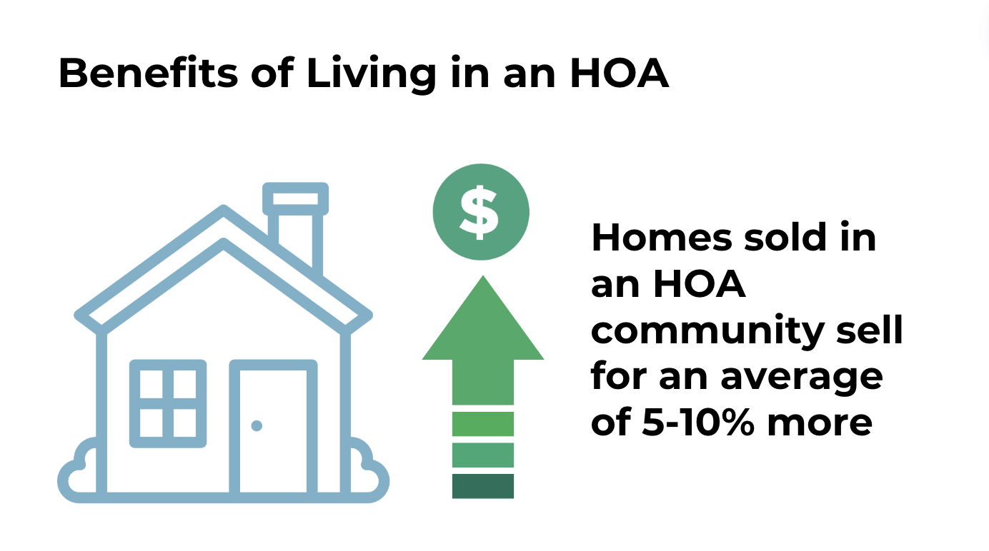

Slide 4
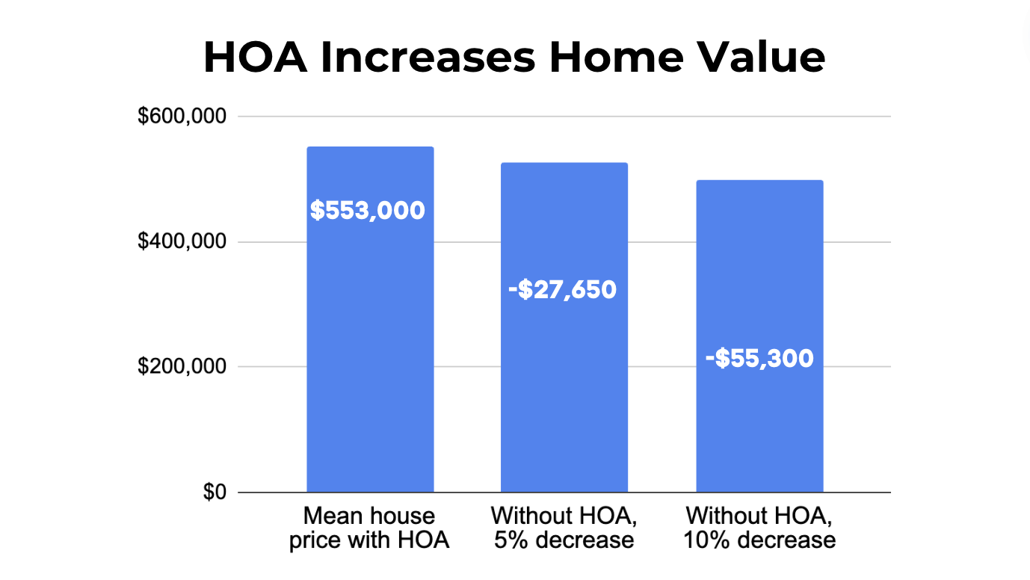

Slide 5
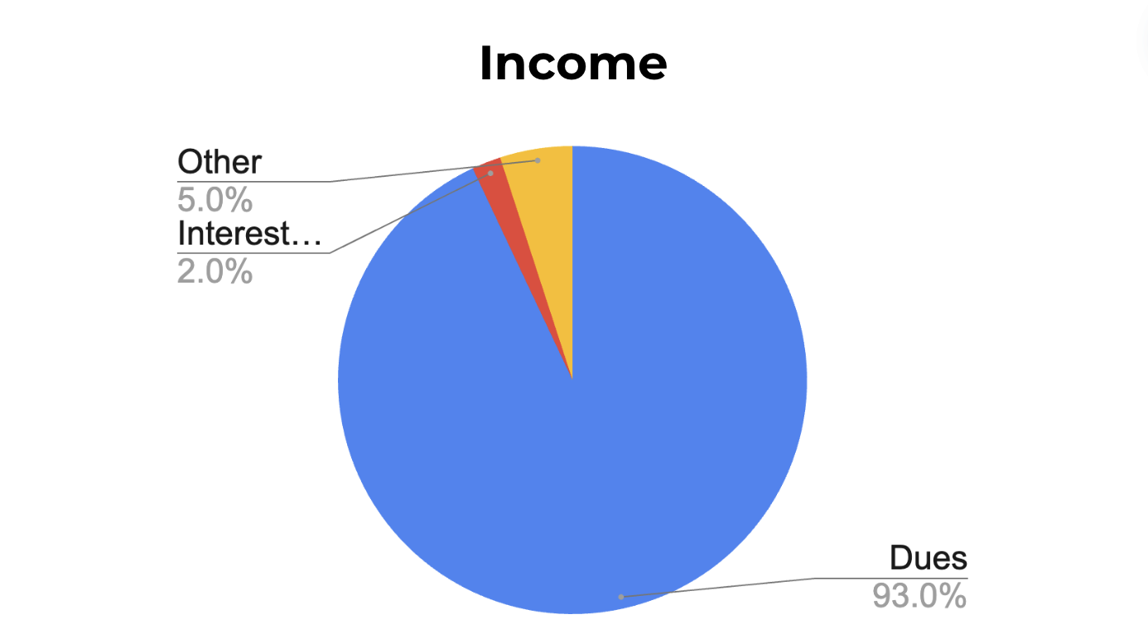
Total budget = $294K; Does not include the $85K from reserves for this year
Interest and late fees
Other: diaper sales, pool fees, transfer fees…

Slide 6
Income and Expenses for This and the Next Eight Years
Reminders:
93% of our income comes from from dues (this year dues total = $274,050)
Our current reserves are $426,886
Bayshore has a 30-year maintenance plan for maintaining its property, facilities, and equipment. We are approximately four years into that plan.
  For the next eight years combined, the estimated costs for upkeep of property, building facilities, and equipment is $500,000.

Slide 7
Income and Expenses for This and the Next Eight Years
Reminders:
Based on projections (0-7%) of the current budget and after paying routine expenses, Bayshore may have an average of $2,537 in discretionary funds for each of the next fiscal eight years (approx. $20,000 across eight years)
Fact: Along with our current reserves, there are not enough funds to pay for the planned maintenance jobs (much less unplanned jobs)

Slide 8
How Does Bayshore Meet Its Financial Needs/Obligations?

Slide 9
Could We Just Use Bayshore’s Reserves?

Slide 10
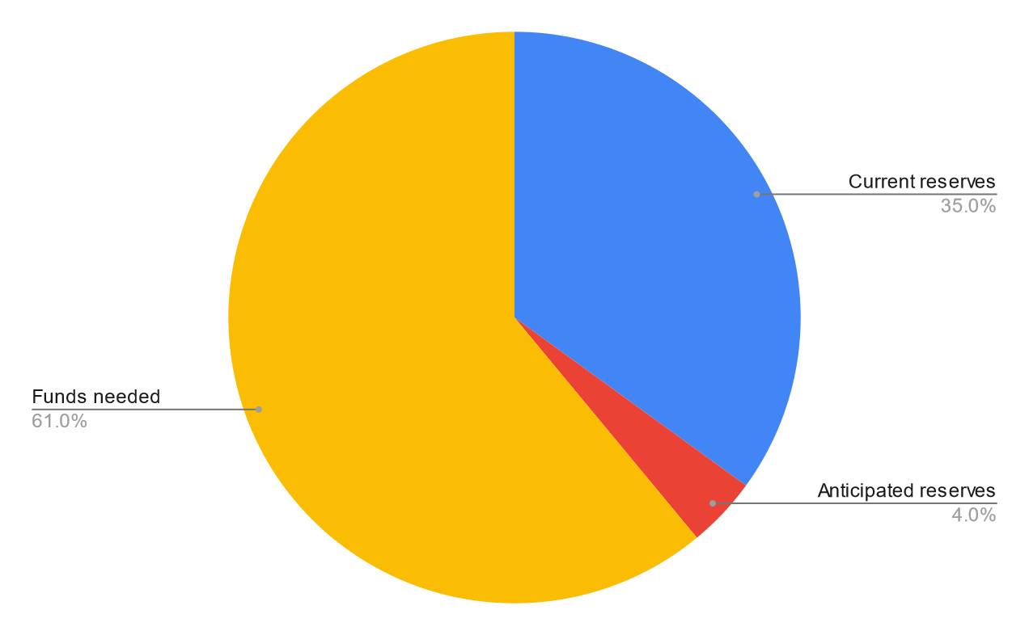
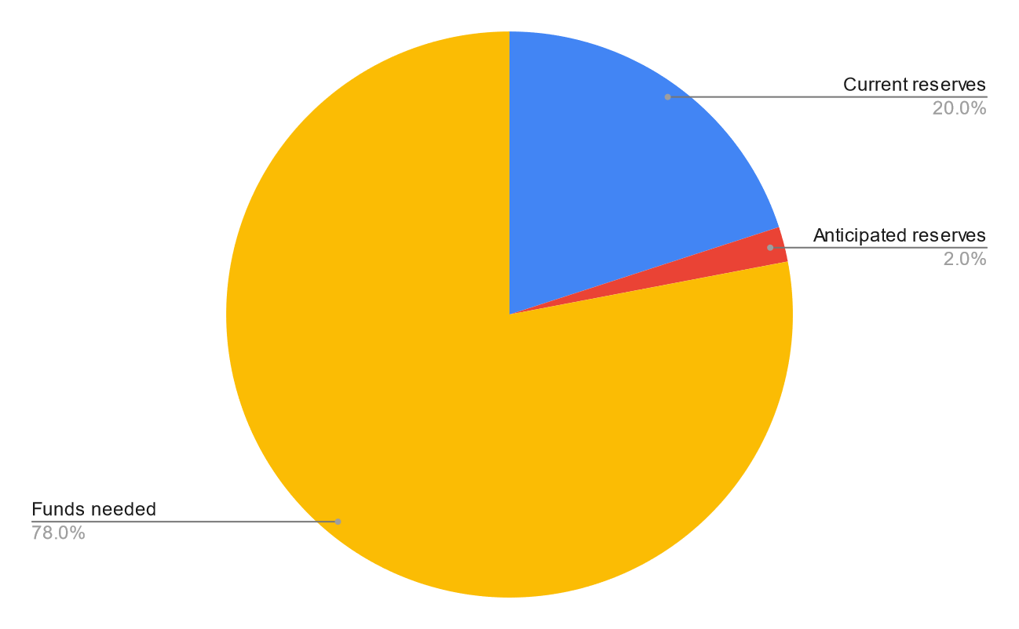
Using All But $250K of Bayshore’s Reserves
$176,000
$176,000
$20,293
$303,707
$694,707
$20,293
30-year plan only: $500K est.
Including tabled items: $891K est.

Slide 11
The Use of Bayshore’s Reserves Doesn’t Meet Financial Needs

Slide 12
Member Dues Could Be Increased

Slide 13
Bayshore Dues History
In 1963, dues were set at $20/year. That is equivalent to $205 in today’s economy.
There have been 61 opportunities to raise the dues.
  If each opportunity was taken, dues currently would be $630/year ($52.50/mo.)
Dues were raised* 25 times (57%) to get to our current $270/year.
Current dues are $270/year or $22.50/mo.
*Dues were reduced one year

Slide 14
What Does It Take to Increase the Dues?
Bayshore’s dues structure is written into the C&Rs.
To change the C&Rs, 2/3 of all members must approve the change.
Some members suggest that a change to the C&Rs is impossible; that not enough members will vote for a change.
  We will never know if a change is possible until we try.
  Members have shown their support for and have gone out of their way to support Bayshore numerous times in the recent past (e.g., Artisans, Weed-Whackers, extra dues donors, donors to the beach access project).

Slide 15
Potential Change to C&Rs Language
“Dues shall be raised each year no less than 4% and no more than 10% above the current dues”

Slide 17
Dues Task Force Analysis
Bayshore could increase the dues by 10% next year and continue to increase dues by 10% the following 7 years
If the dues were increased as such, Bayshore would be back on a much more solid financial foundation including having funds to cover the renovation and some unplanned jobs
    Some unplanned jobs could be covered with some of the current reserves as well
  Dues after 8 years will have gone up an additional $309 ($26/mo.)
Note: The current average HOA membership fee for a single-family home in Oregon is $300 per month ($3,600 annually).
Notes:
Sources Living Cost, Wool Worth on Fifth and
Top Nutrition Coaching websites.

Slide 18
Member Suggestion
Shut Down the Pool Permanently

Slide 19
Effect on Budget with Shutting the Pool Down Permanently
Would save an estimated $46K a year in costs: personnel, chemicals, regular repairs, and estimated costs for propane
Without pool:
  Would result in $471,000 for reserves across eight years (vs. $20K)
  Bayshore’s 30-year maintenance plan for property, facilities, and equipment for the next eight years combined would be an estimated $448,000 (vs. $500K)
Across eight years, the estimated annual costs (Bayshore’s annual budget) plus funds put into the reserves result in an extra $23Kof discretionary funds.
Numbers above do not include funds for unplanned jobs (this year: $78,000) or tabled jobs (i.e., clubhouse reno, tennis court = approx. $391K)

Slide 20
Cons to Shutting Down the Pool Permanently
Pool is what attracted many members to purchase in Bayshore
Most real estate ads for homes in Bayshore include mention/picture of pool
Pool is used notably in summer
  For an average week, there were 686 visits/uses (93% were members and their families; 7% were renters of Bayshore homes)
There were positive comments re: the pool in the 2021 member survey

Slide 21
Results of 2021 Survey re: Pool
Pool was fourth on list re: greatest hope of maintaining Bayshore’s facilities
Top item for “Three issues about what Bayshore offers that should be addressed (improved)”
Bottom line: Closing pool permanently does not help Bayshore address tabled jobs, unplanned jobs, and rising costs of living.

Slide 22
Questions?

